Slide 1


Intensive Course Biology for Technology Department of Agricultural Technology Faculty of Technology, University of Colombo by Dr. Aruna Kumara Udawasala

Slide 2
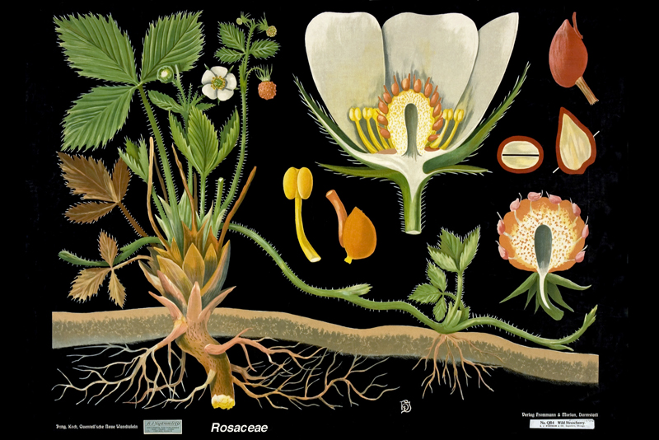
Kingdom Plantae

Slide 3
Basic Characteristics
Organisms within Kingdom Plantae are multicellular, eukaryotic, autotrophic and they lack mobility.
Plants produce food via photosynthesis and have cell walls composed of cellulose.
The history of life on earth and the success of many organisms depends on the success of plants.

Slide 4
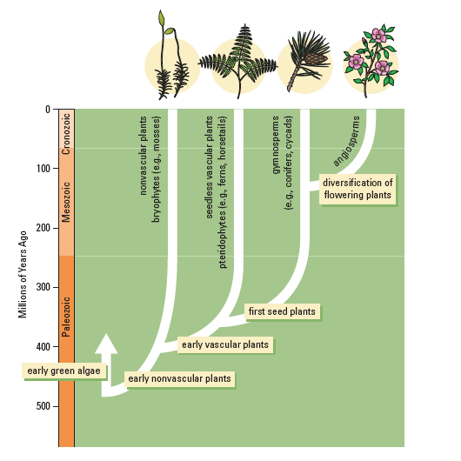
Evolution of Plants

Slide 5
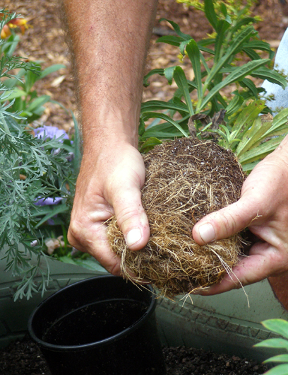
Three Main Parts of Plants
Roots penetrate the soil and anchor the plant to the ground.
The roots absorb minerals and water from the soil to be used in photosynthesis.

Slide 6
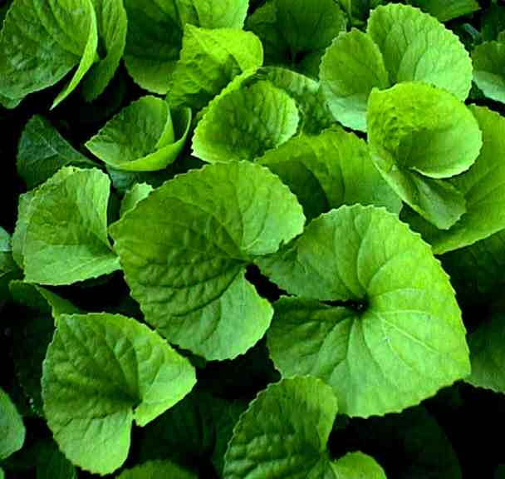
Three Main Parts of Plants
Leaves provide a large surface area for the absorption of sunlight.
Photosynthesis occurs inside the chloroplasts of the cells of the leaves

Slide 7
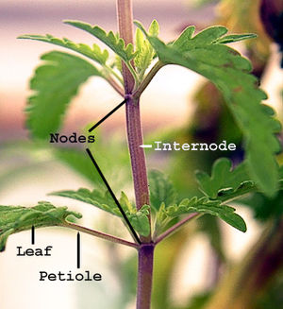
Three Main Parts of Plants
Stems are composed of rigid tissue that raise and support the leaves.
Stems also transport substances from the roots to leaves and from the leaves to roots.

Slide 8
Classification of Plants
Plants are divided into the four main groups based on two major characteristics: presence or absence of vascular tissue and seeds.
Vascular tissue transport substances such as water, minerals and sugars throughout the plant.
Seeds are structures that contain an embryo, stored food and an outer coat.

Slide 9
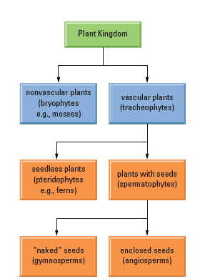
Divisions of Kingdom Plantae

Slide 10
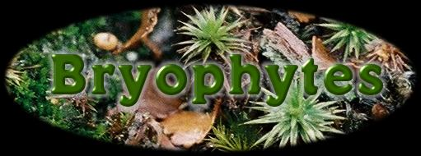
Non-Vascular Plants
Non-vascular land plants do not contain any conducting tissues and are often referred to as bryophytes. These plants are small, grow close to the ground and include mosses and liverworts.

Slide 11
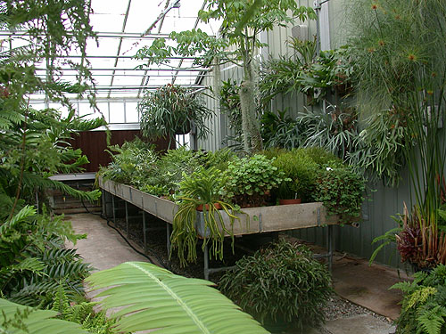
Seedless Vascular Plants
Seedless vascular plants contain vascular tissues but do not produce seeds.
This group includes horsetails, ferns and club mosses.

Slide 12
Seed Producing Vascular Plants
Seeded vascular plants also contain extensive vascular tissue and the majority of species in the plant kingdom are in this group. They have a seeds that contain an embryo, a nutrient supply and a protective outer coat.
Seeded vascular plants are divided into angiosperms and gymnosperms.

Slide 13
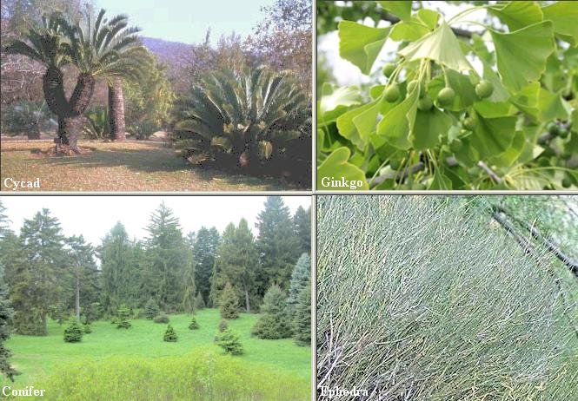
Gymnosperms
Gymnosperms are non-flowering plants with seeds that do not develop within an enclosed structure

Slide 14
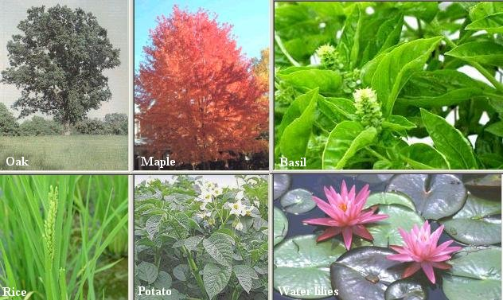
Angiosperms
Angiosperms are flowering plants with seeds that develop inside a protective structure.

Slide 15
Sexual Reproduction
Plants carry out sexual reproduction which means the meeting of male and female gametes.
Mosses and ferns rely on rain and dew to transport the male gametes.
Seed producing plants rely on wind and insects to carry the male gametes to the female parts of plants.
After fertilization the zygote develops in the seed where it can remain dormant for long periods of time and survive drought, freezing and even fire.

Slide 16
Plant Structures
Plants contain structures other than the three main parts mentioned earlier and these structures have very specific functions.
Plant structures include rhizoids, xylem, phloem, cuticle and stomata.

Slide 17
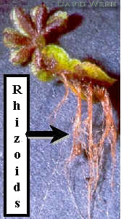
Rhizoids
Rhizoids are small hair-like structures that transport materials and anchor the plant.

Slide 18
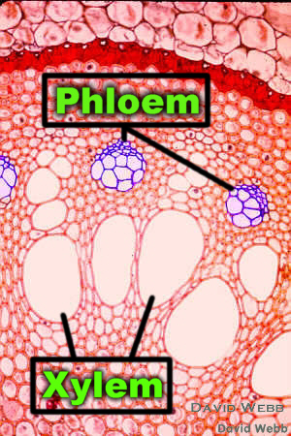
Xylem and Phloem
Xylem are hollow tubes made of dead cells that transport water from roots to leaves.
Phloem are hollow tubes made of living cells that transport glucose made during photosynthesis from the leaves to the rest of the plant.

Slide 19
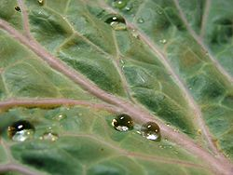
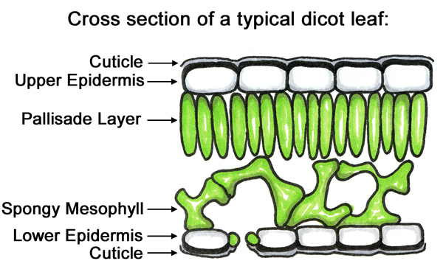
Cuticle
The cuticle is a waxy covering on the stems and leaves of plants.
The cuticle prevents water loss in plants

Slide 20
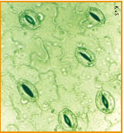
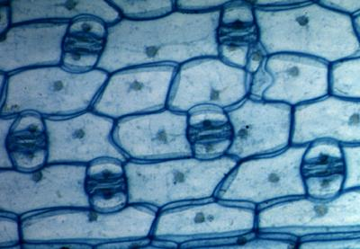
Stomata
Stoma are microscopic openings or pores in leaves.
The stoma are the pores through which the exchange of gases occurs in plants.
Some water is also lost through the stoma in a process known as transpiration.

